Slide 1
Presentation material links
Resources:
Playbook
Presentation Guide
Email Invite
DELETE THIS SLIDE PRIOR TO PRESENTING

Slide 2
Co-Marketing in Total Expert
Sell more homes and build your brand

Slide 3
What is Total Expert?
Co-Marketing Overview
Key Features
Benefits of Co-Marketing
How to Get Started

Slide 4
What is Total Expert?
Industry leading, purpose-built CRM and customer engagement platform
Specifically designed to help realtors build their brand and grow their business, alongside loan officers

Slide 5
Co-Marketing Portal
in Total Expert
Total Expert is available to every real estate agent and anyone in financial services
Partners have access to a FREE version of Total Expert, including a suite of powerful, user-friendly tools
Live, local support is available six days a week
Notes:
https://totalexpert.com/co-marketing/

Slide 6
Co-Marketing
Features

Slide 7
Print Marketing
Email and Drip Campaigns
Lead and Contact Management
Lead Capture Apps
Single Property Websites
Lead Activity Training
Key Features

Slide 8
Benefits of Co-Marketing
Branded Print Marketing
Quickly and easily deploy beautiful flyers and brochures.
Open House Automation
Stay in front of leads through automated communications to open house registrants
Campaigns
Create custom drip communications that are timely, relevant, and personal.
Single Property Sites
Create dynamic, co-branded webpages for upcoming listings
Lead and Contact Management
Build customer relationships alongside lending partners by managing your shared leads in one place
Lead Activity Tracking
Track lead activity to identify opportunities and deliver value to customers at critical moments throughout their journey

Slide 9
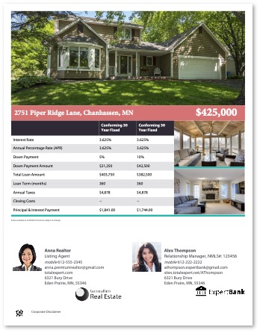
Branded Print
Marketing
Save time and money
Ensure RESPA compliance
Targeted Distribution
Notes:
https://totalexpert.com/focused-view/

Slide 10
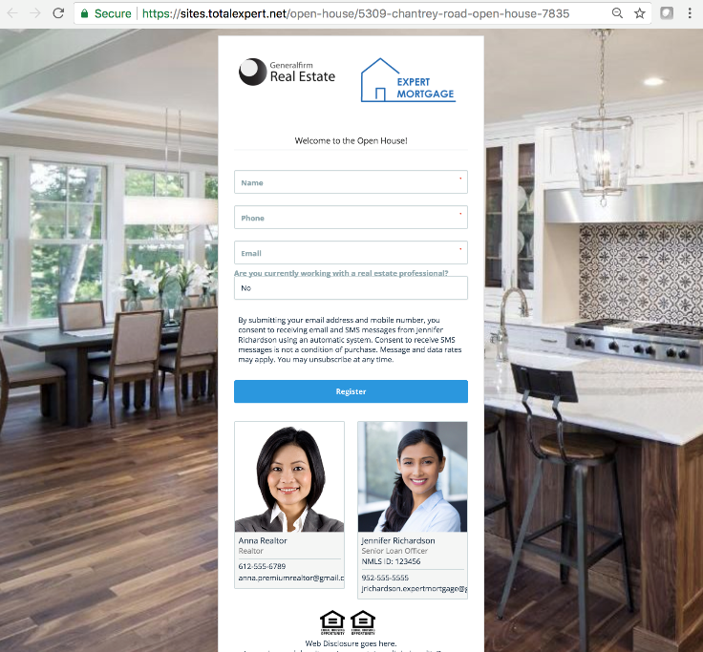
Lead Capture Apps
Lead generation tool
Multiple templates available
Captures leads in-platform
Allows you to automate follow up

Slide 11
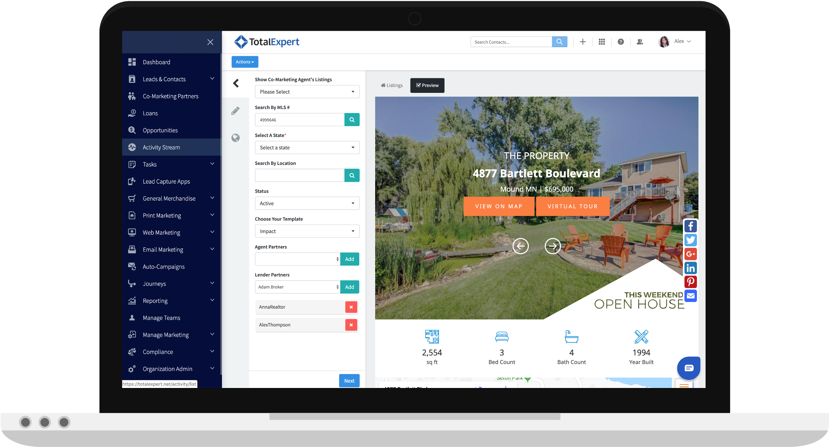
Single Property Sites
Attract and engage homebuyers with a beautiful, co-branded property website.
MLS integration
Multi-channel optimization
Only 5 clicks
Notes:
https://totalexpert.com/focused-view/

Slide 12
How to Become a
Co-Marketing Partner

Slide 13
1
Call, email, or text
Three Easy Steps
2
Accept the invitation
3
Start collaborating
Notes:
So here

Slide 14
INSERT YOUR HEADSHOT HERE
Call, Email, or Text
Let me know if you want to connect or learn more about Co-Marketing
You can reach me M-F 9 a.m. - 5 p.m.
Call, email, or text. Whichever is better for you.
Your name here
P: 987-654-3210
E: youremail@email.com

Slide 15
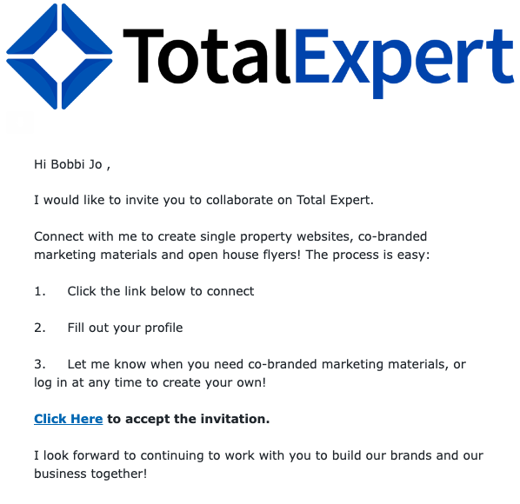
Accept the Invitation
Check your inbox for an invitation
The email invitation will come from Total Expert
If you don’t get it, reach out to me and I will resend to you
Make sure to accept the invitation and set up your profile

Slide 16
Start Collaborating
Explore the different features available to you in Total Expert
Check out the Training Resource Center
Questions? Reach out to support, which is available six days a week

