Slide 1
Instructions Page
Delete slide before presenting
Be sure to review all the slides before presenting and delete any that do not make sense for your organization
Replace screenshots with screenshots of your organization’s Journey, if you wish
Customize end-user instruction slides with accurate information for end users based on how your Journey is set up
Edit call scripts to reflect the content in your Journeys

Slide 2
Customer Intelligence Alerts
End User Training

Slide 3
Mortgage Credit Inquiry Alert
Rate Alert
Equity Alert
Listing Insights
Four Core Customer Intelligence Alerts

Slide 4
Mortgage Credit Inquiry Alert
Customer Intelligence

Slide 5
What is a Mortgage Credit Inquiry?
A Mortgage Credit Inquiry Alert notifies you when a contact applies or requests pre-approval for a mortgage at a competing lender or bank
The alert is generated by Equifax, which sends Total Expert an alert each time a bank pulls a consumer’s credit. If one of those alerts matches with a contact in your Total Expert account, it will surface an alert to you.

Slide 6
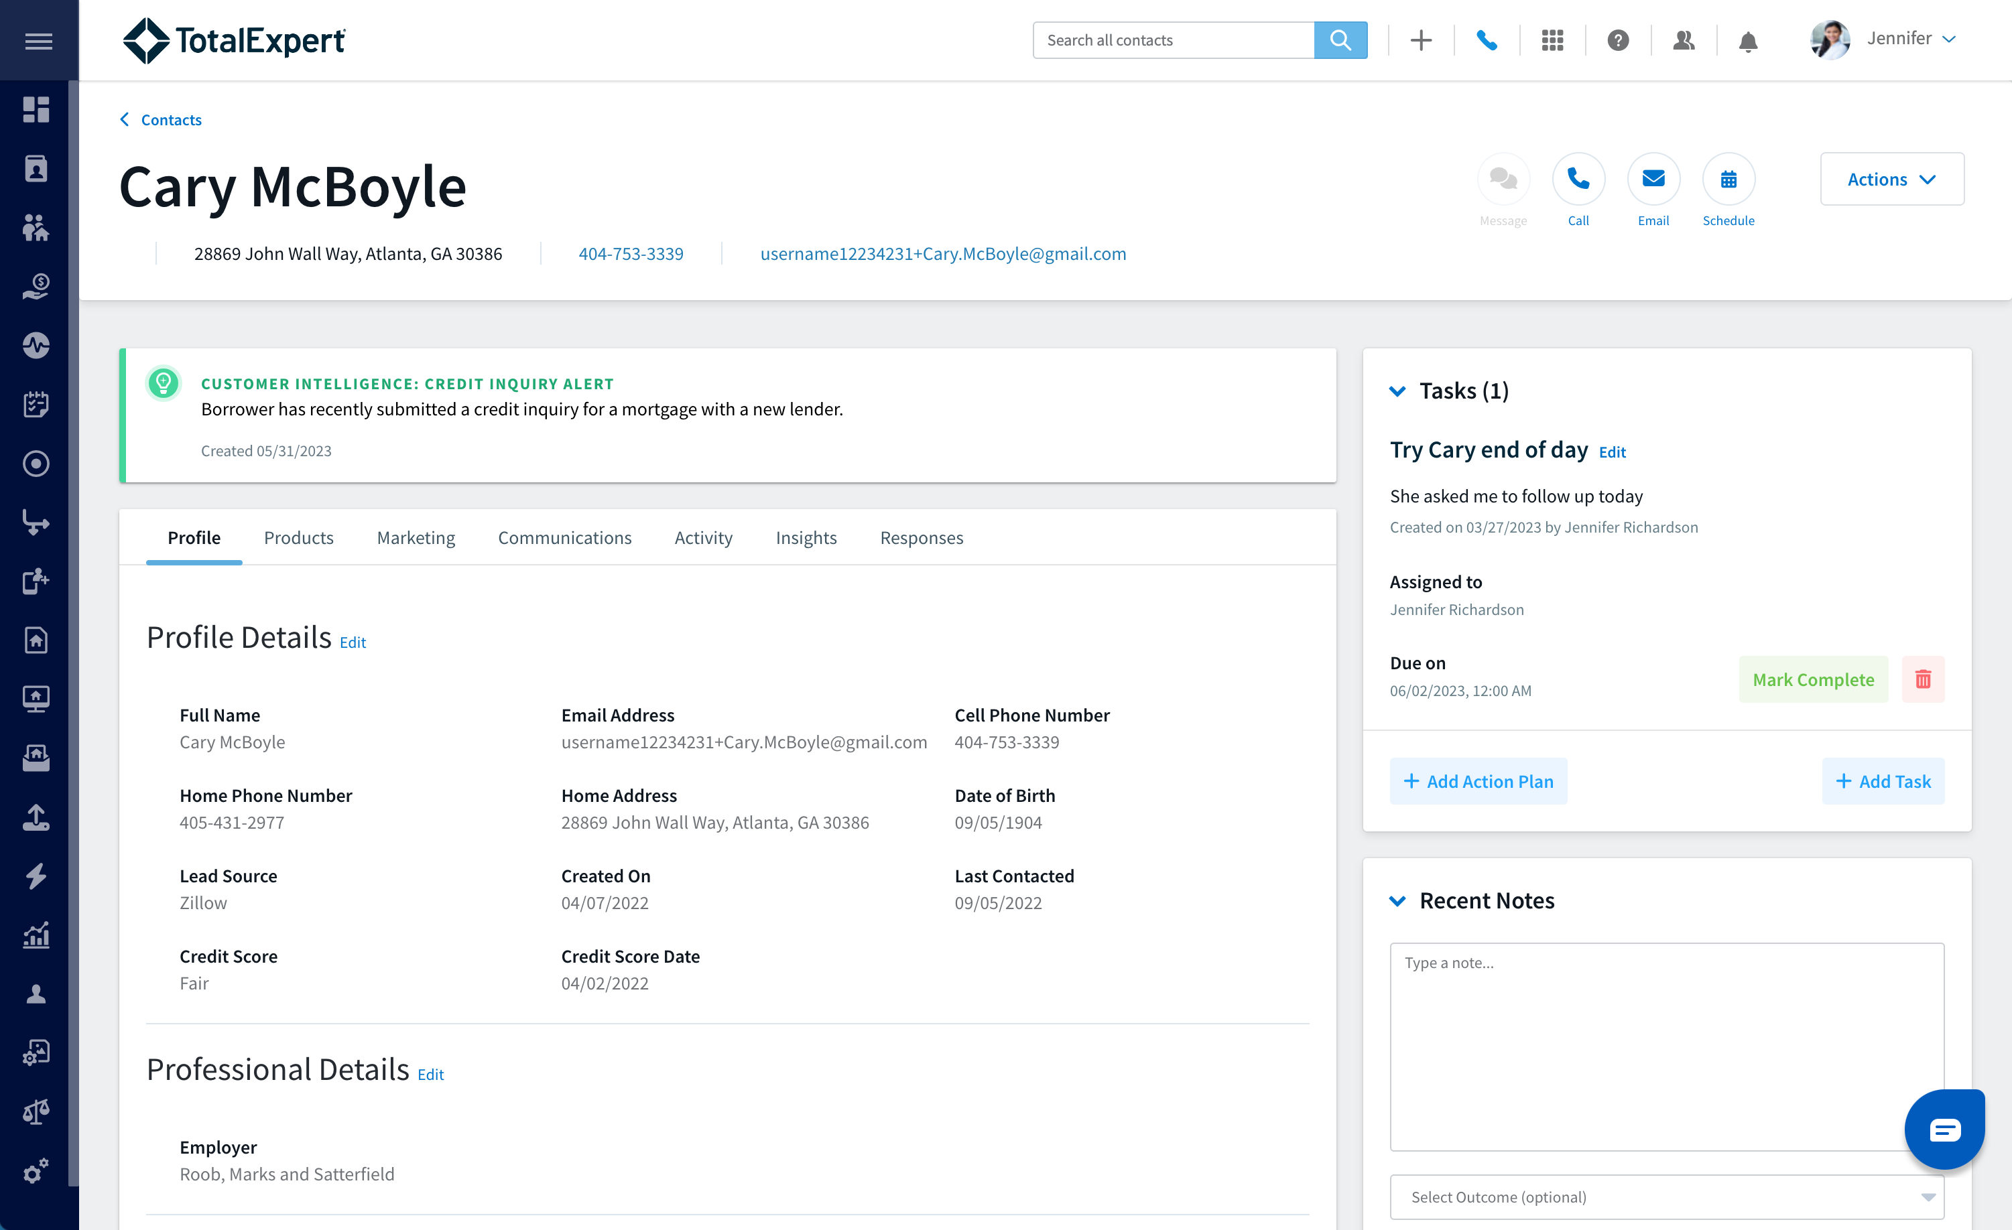
Example

Slide 7
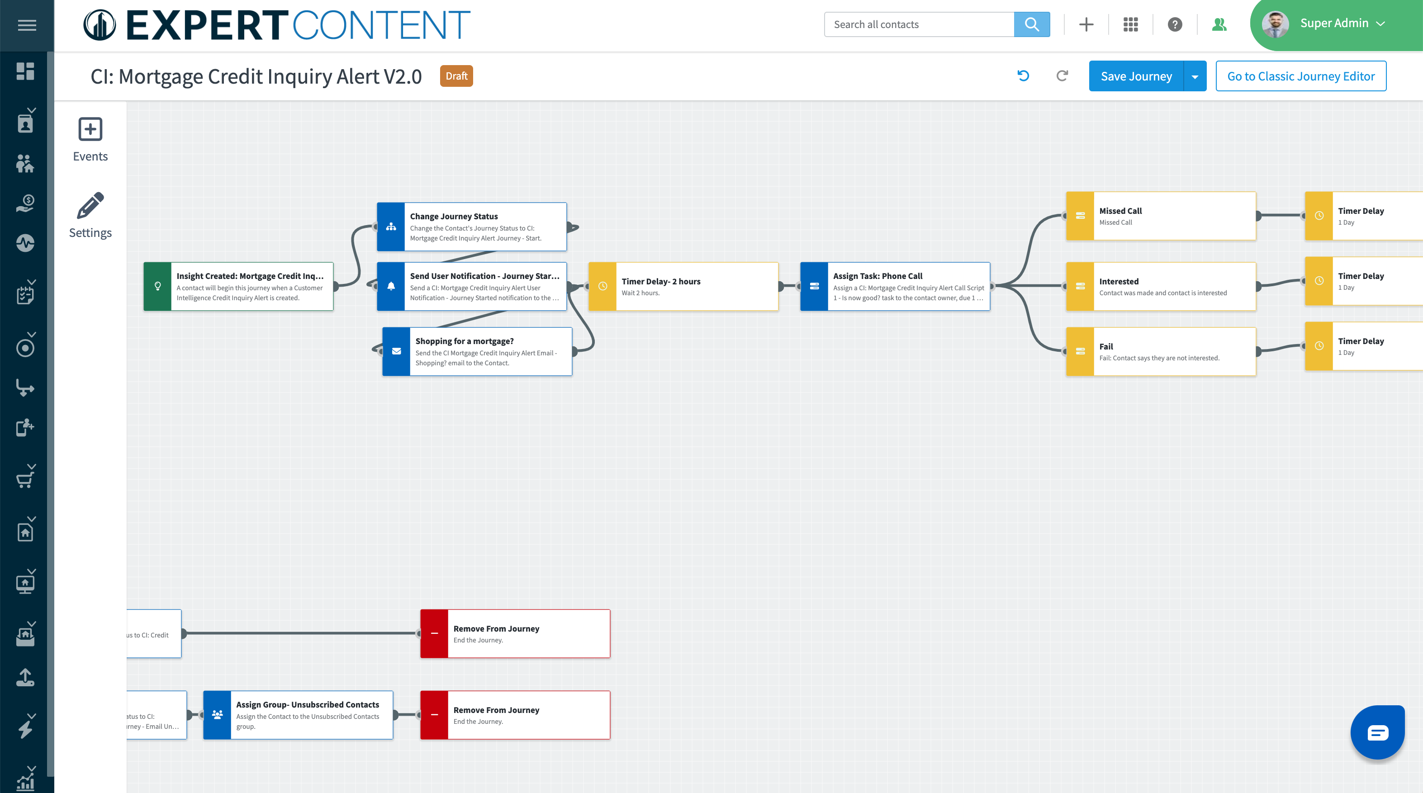
Understanding the Automation
Task Outcomes
Task Assigned
Automated Communication
Notes:
Notes:
Replace image with your organization’s custom journey
Walk through the important parts that they need to know about: automated communication, task assignment, task outcomes

Slide 8
What you need to know about Credit Alerts:
When a Mortgage Credit Inquiry is generated, a FOC Journey will deliver the FOC email and/or print content to the consumer
Make sure you are following up on any tasks associated to the insight (ie. phone call)
Based on the outcome of the call, make sure to select an outcome to keep the automation running (ie. missed call, interested, fail)
Log any notes from the call on the contact record
Notes:
Customize to your organization

Slide 9
Example Call Script
“Hi [contact first name],
It’s [your first name], [your title] with [your company name]. I'm reaching out because I see that you're in the market for a new mortgage. I'd like to learn a little more about your financing needs and share how I may be able to help. Is now a good time?
If yes: Engage with open-ended questions to better understand needs, then continue:
I can easily take your loan application over the phone right now. That way, we can get a full picture of what loan options work best. It will allow us to have a more detailed and specific discussion.
If no: Ok, if now isn't the best time, I'll send you more information via email about how {mortgage lender} can help find the best loan for you.

Slide 10
Rate Alert
Customer Intelligence

Slide 11
What is a Rate Alert?
A Rate Alert notifies you when market interest rates drop, creating rate/term refinance opportunities for homeowners within your contact database.

Slide 12
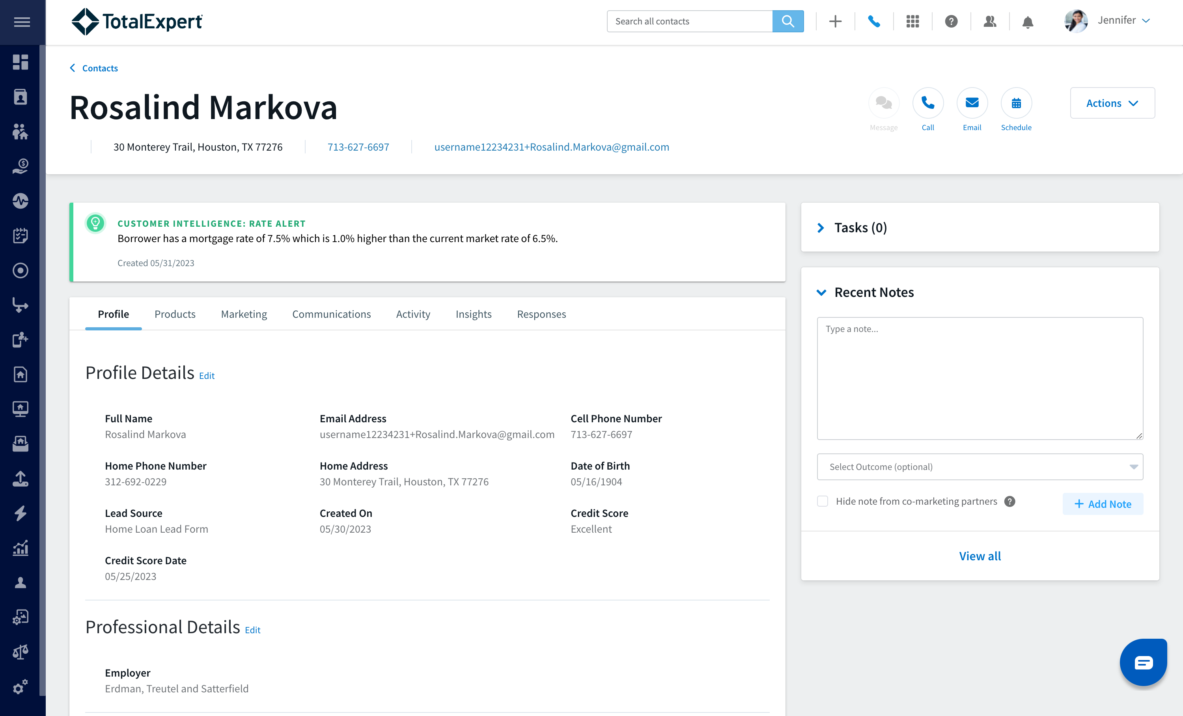
Example

Slide 13
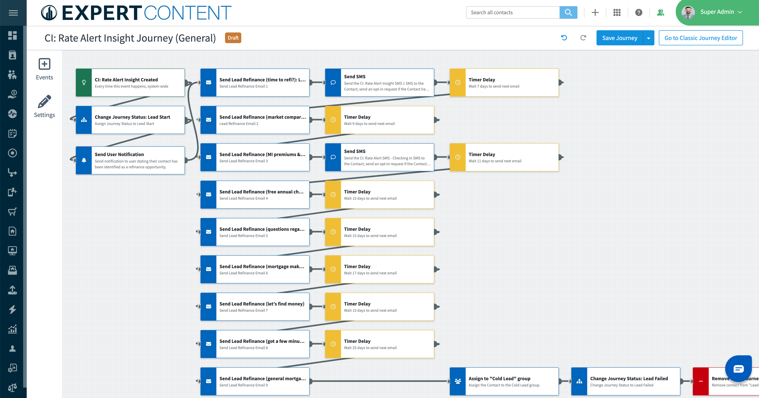
Understanding the Automation
Automated Communication
Notes:
Notes:
Replace image with your organization’s custom journey
Walk through the important parts that they need to know about: automated communication

Slide 14
Example Call Script
“Hi [contact first name],
It’s [your first name], [your title] with [your company name]. Is now a good time to talk?
If no: Arrange an alternate date/time.
If yes: Great! I’m calling to follow up on a few emails I recently sent you. Based on my records it looks like it might be a good time to review your current situation and see if that is still the best option for you based on the rates and market conditions. Would you like me to do a quick equity and mortgage review for you?

Slide 15
Equity Alert
Customer Intelligence

Slide 16
What is an Equity Alert?
An Equity Alert notifies you of homeowners in your contact database who have built up enough equity in their property to potentially benefit from a HELOC, cash-out refinance, or other financing options.
LTV is based on a valuation of their property and the estimated current mortgage balance.

Slide 17
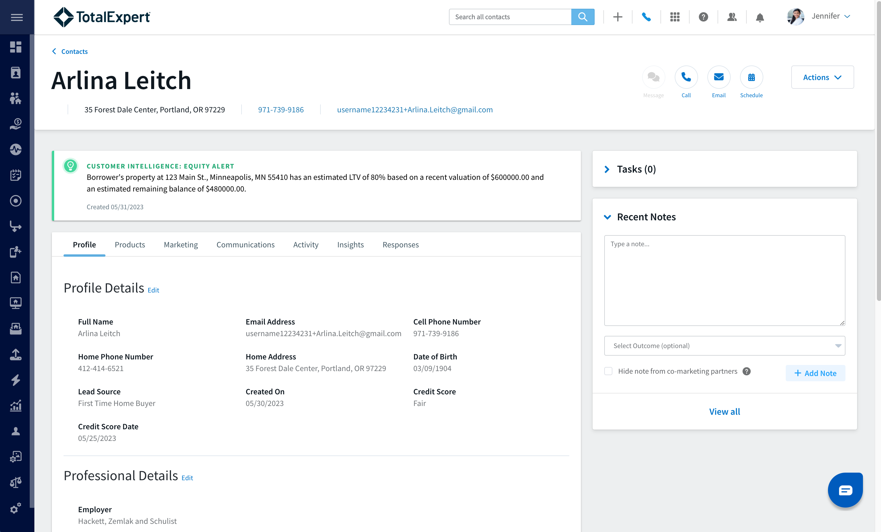
Example

Slide 18
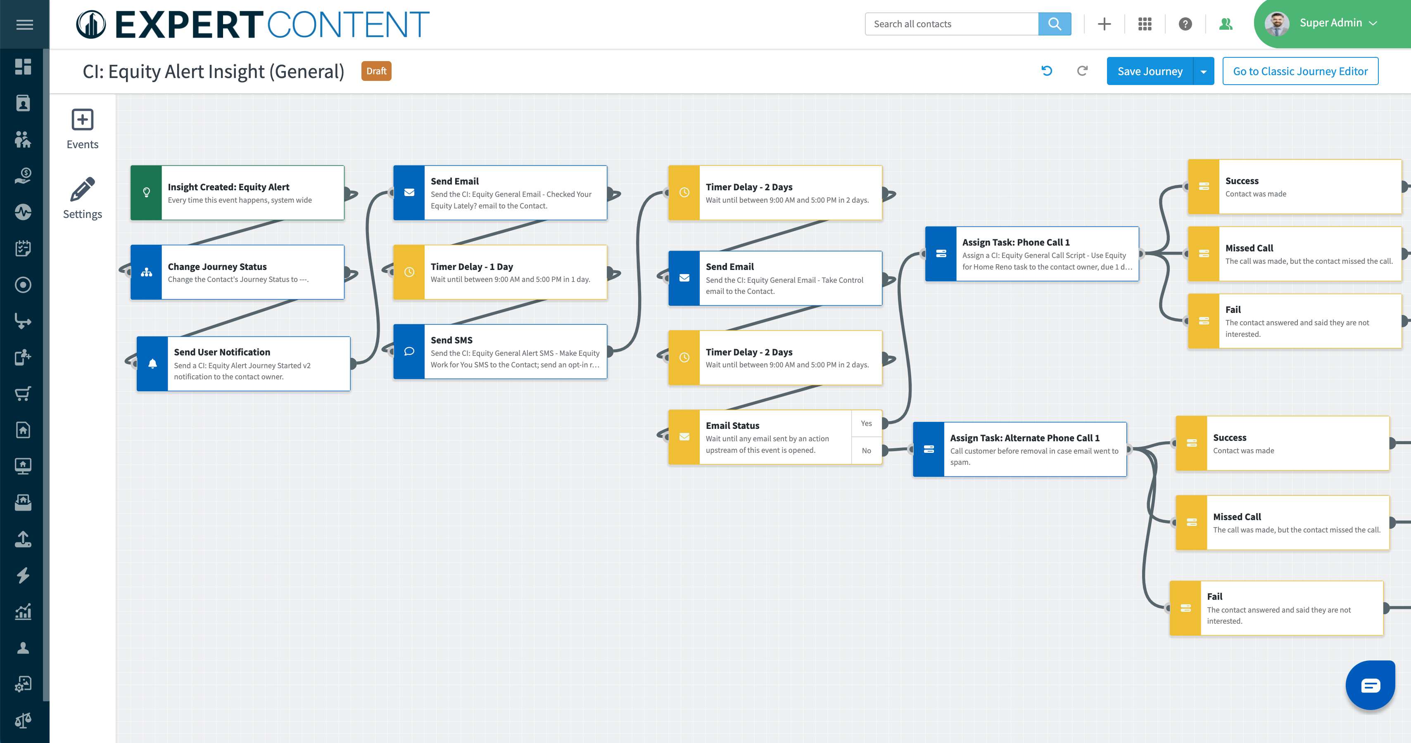
Understanding the Automation
Automated Communication
Task Outcomes
Task Assigned
Notes:
Notes:
Replace image with your organization’s custom journey
Walk through the important parts that they need to know about: emails are going out automatically, tasks being assigned to them, task outcomes.

Slide 19
What to do when you get an Equity Alert task?
When you receive a task notification, log in to Total Expert and pull up the contact record associated with the task
Familiarize yourself with the contact by viewing the below key tabs:
Products - familiarize yourself with their current loan product
Activity - familiarize yourself with their interaction with your previous marketing
Make a phone call using the call script in the associated task
Based on the outcome of the call, make sure to select an outcome to keep the automation running
Log any notes from the call on the contact record
Notes:
Customize to your organization

Slide 20
Example Call Script
“Hi [contact first name],
This is [your first name] with [your company name]. Is this a good time to talk?
If no: Arrange an alternate date/time.
If yes: Great! I’m calling to follow up on a few emails I recently sent you about the equity in your home. You can use the equity in your home to finance just about any home renovation product, including system upgrades and additional rooms. Those are just a few of the ways you can use it, but there are several options available to you! Have you thought about this at all,or are you interested in learning more about the equity in your home?

Slide 21
Listing Insights
Customer Intelligence

Slide 22
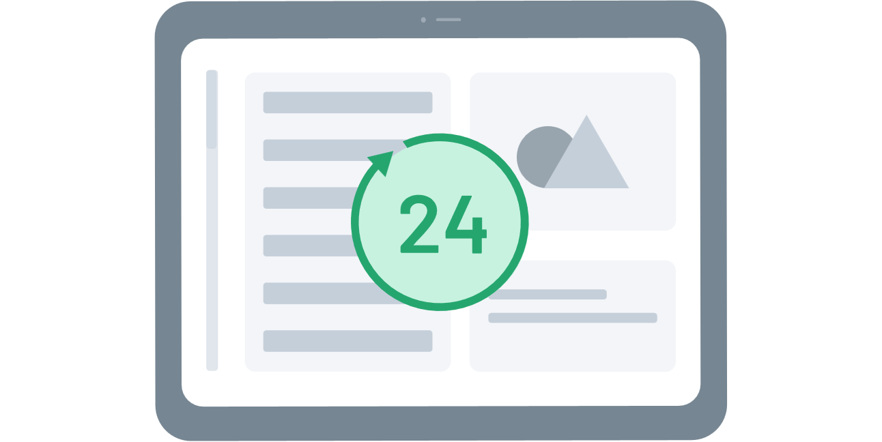
What are Listing Insights?
A Listing Insight is an alert that is added to a client contact record in Total Expert.
It notifies you when a client has listed their property within the last SEVEN days.
7

Slide 23
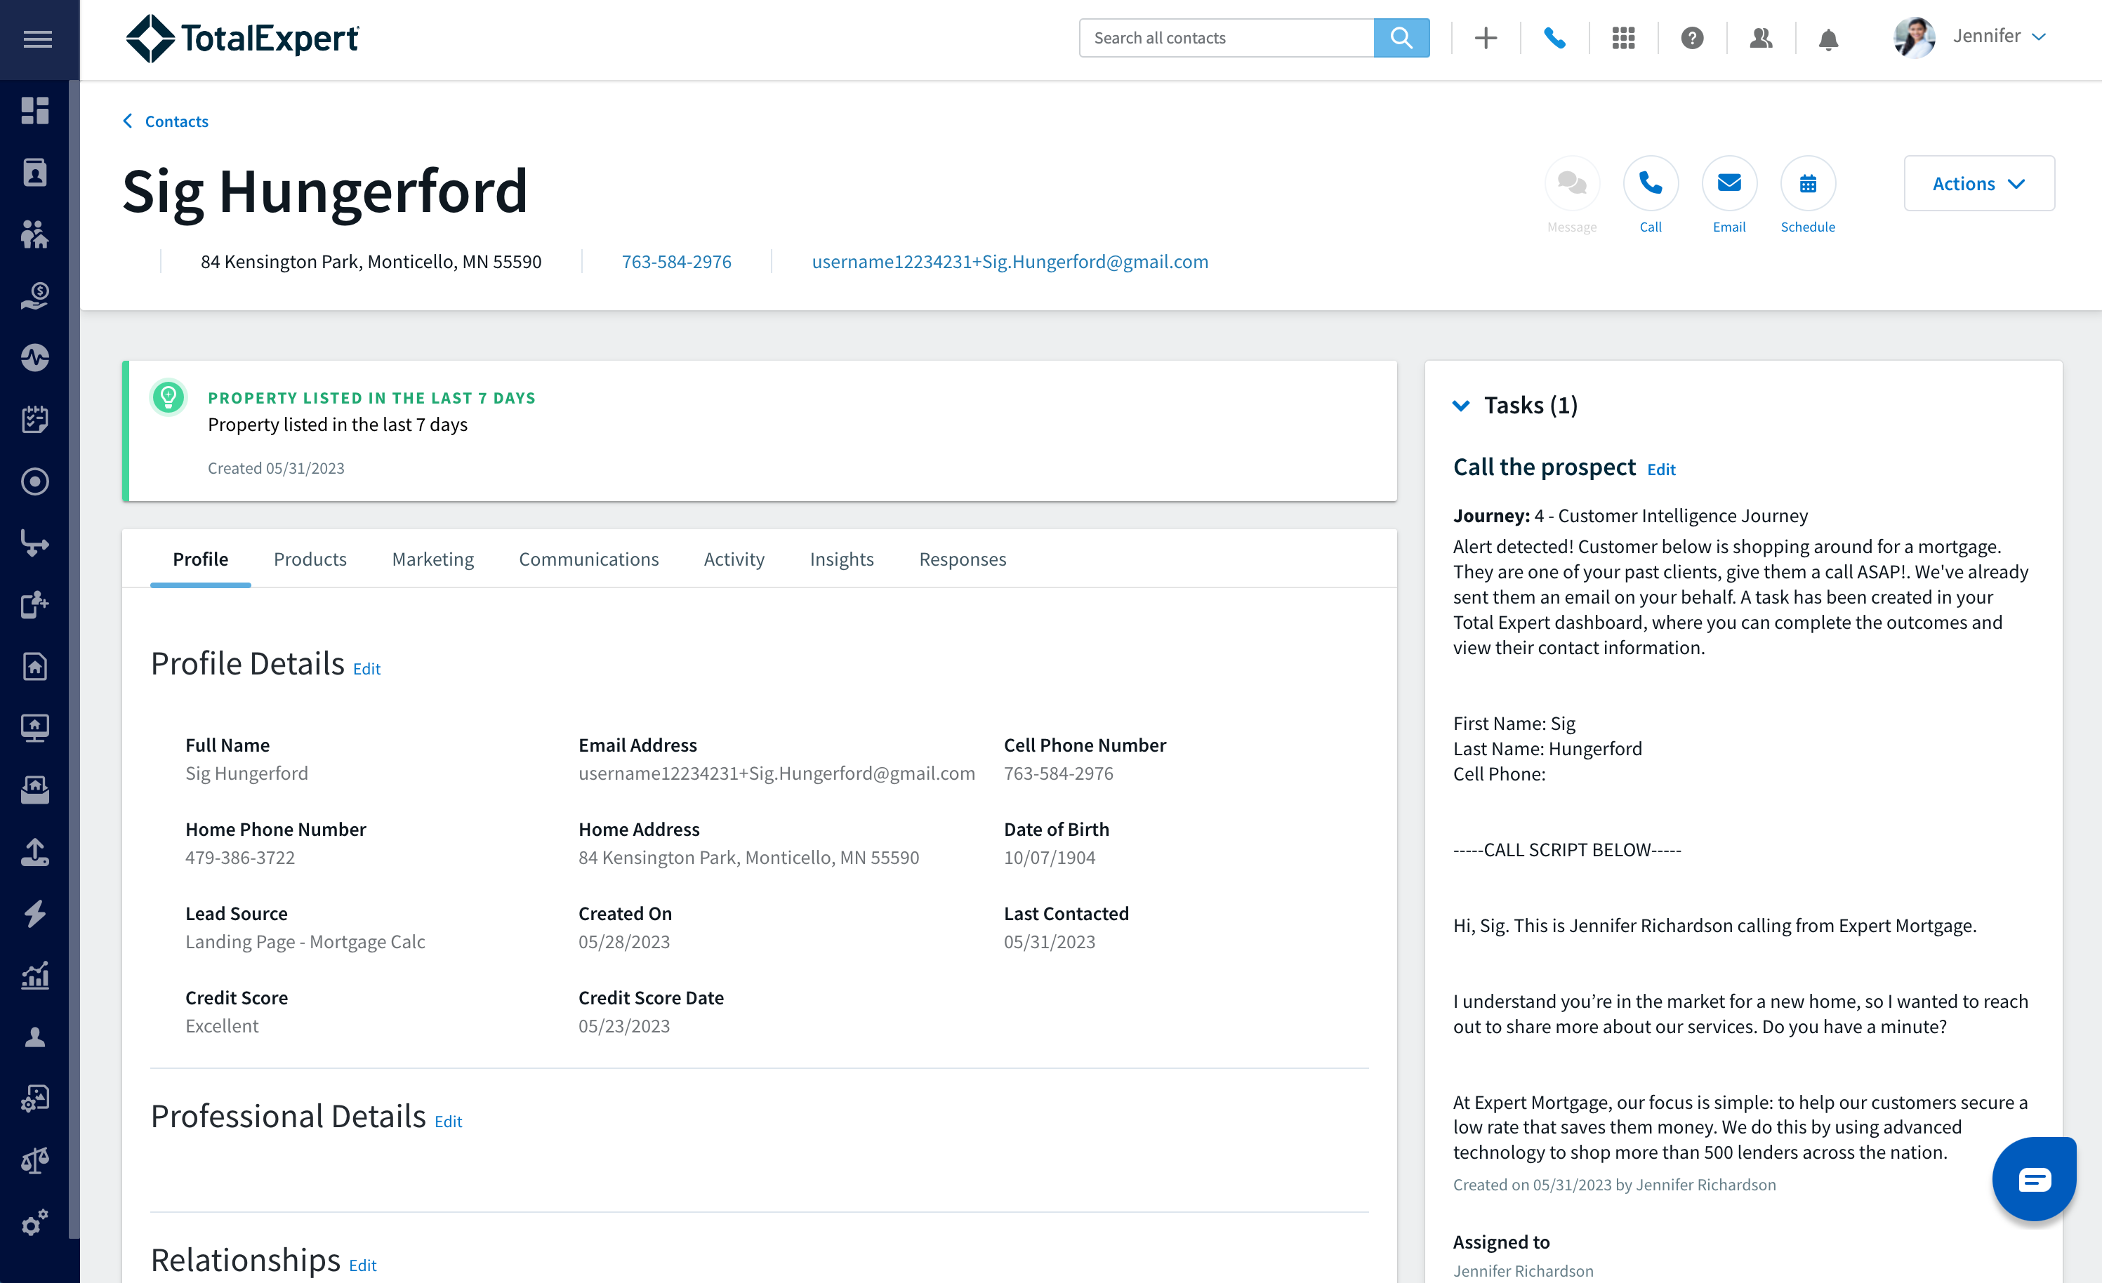
Example

Slide 24
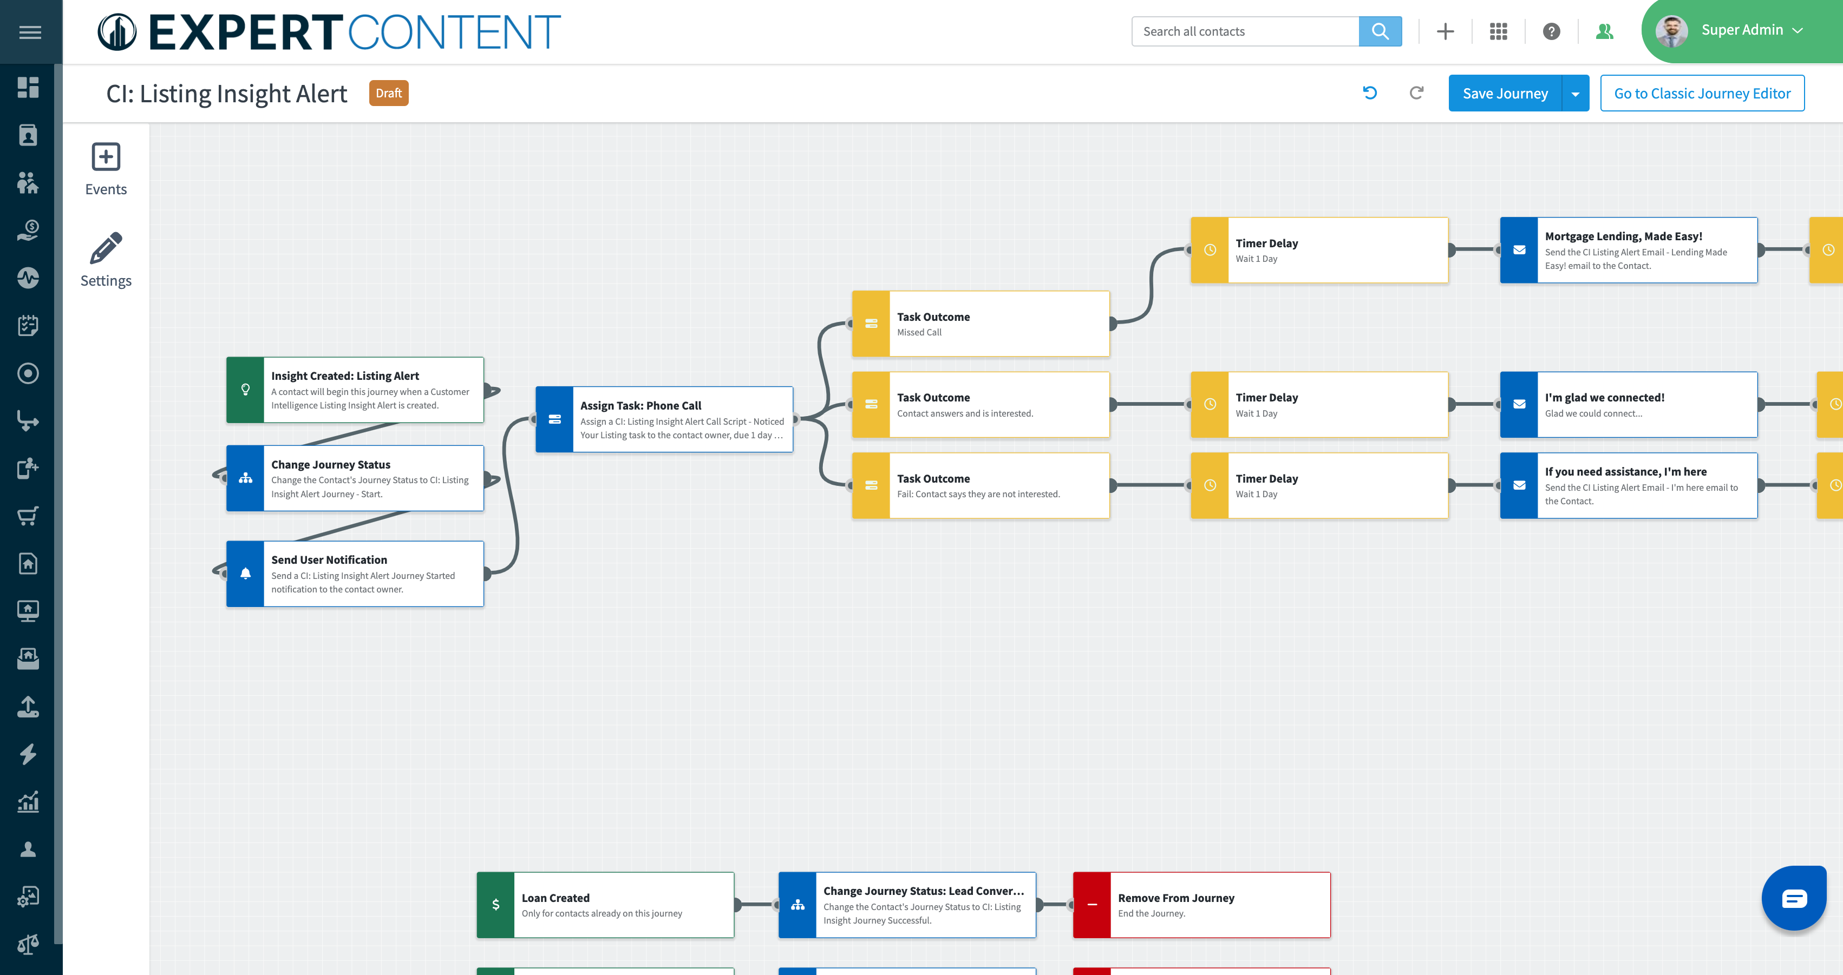
Understanding the Automation
Task Outcomes
Task Assigned
Automated Communication
Notes:
Notes:
Replace image with your organization’s custom journey
Walk through the important parts that they need to know about: emails are going out automatically, tasks being assigned to them, task outcomes.

Slide 25
Example Call Script
“Hi [contact first name],
It’s [your first name], [your title] with [your company name]. I wanted to reconnect with you and remind you that my team and I are always available to help you work through any changes to your housing needs either now or in the future.
Have your housing needs changed recently? Is there anything I can help you with right now?
If I can ever help answer any of your questions or provide you with resources, please don’t hesitate to reach out.”

Slide 26
Listing Banner on Contact Record
Insights History Tab
Journey Automation
Tasks and Notifications
Focused View
Ways You Will Leverage The Alerts:

Slide 27
Listing Banner on Contact Record
Alert appears in the banner at the top of the contact record
Alert ‘created date’ appears at the bottom of the insight

Slide 28
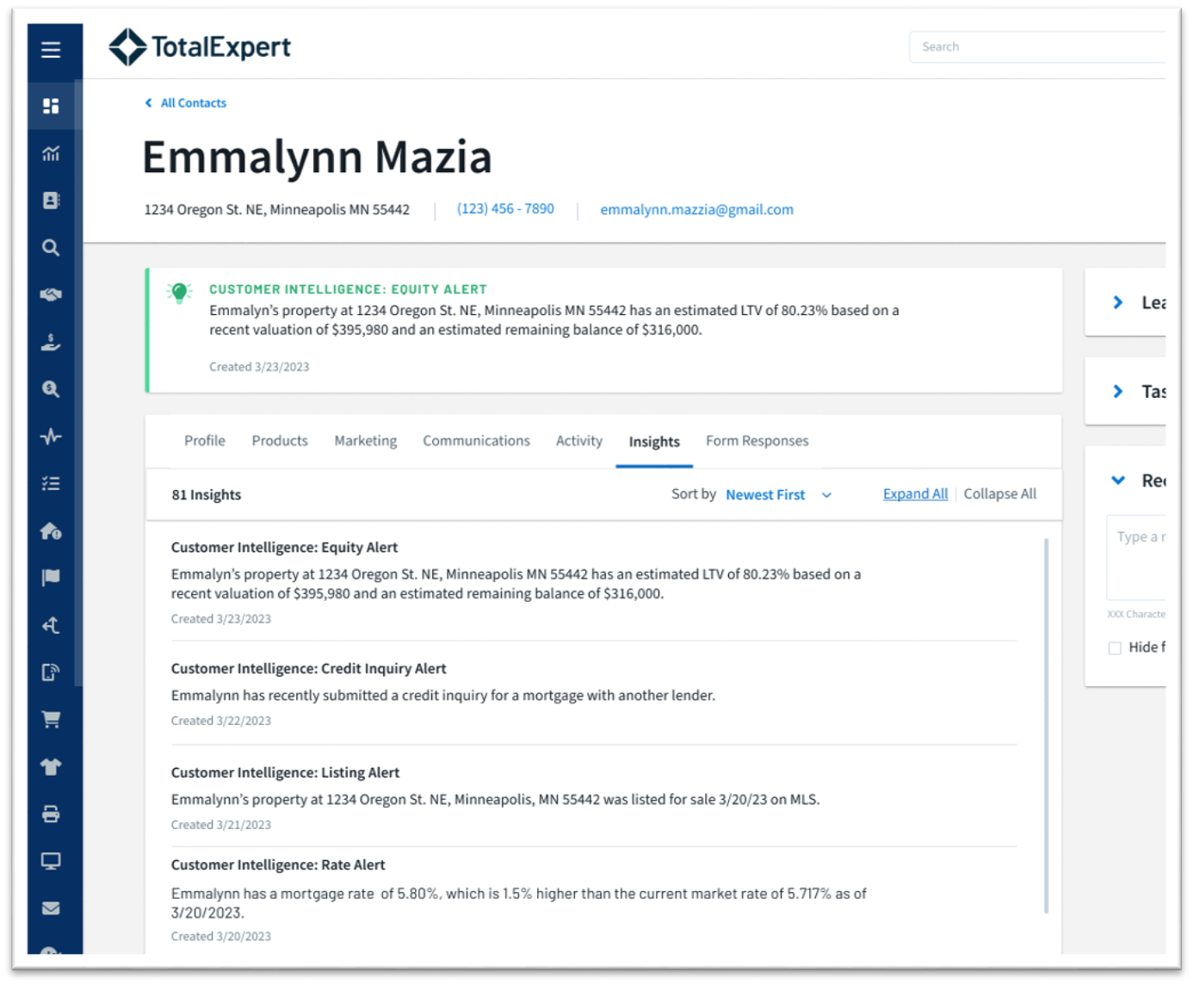
Insight History Tab
Enhanced visualization of insights on the customer record in TE
Created dates on insights/alerts
Highlights and tracks all historical insights/alerts

Slide 29
Automated Communication
Task Notification
Journey Automation
User Notification

Slide 30
Tasks and Notifications
Receive an email notification when an insight is created
Receive task notifications to follow-up at the right time, with the right message
**Ensure your task notifications are turned on in your account settings

Slide 31
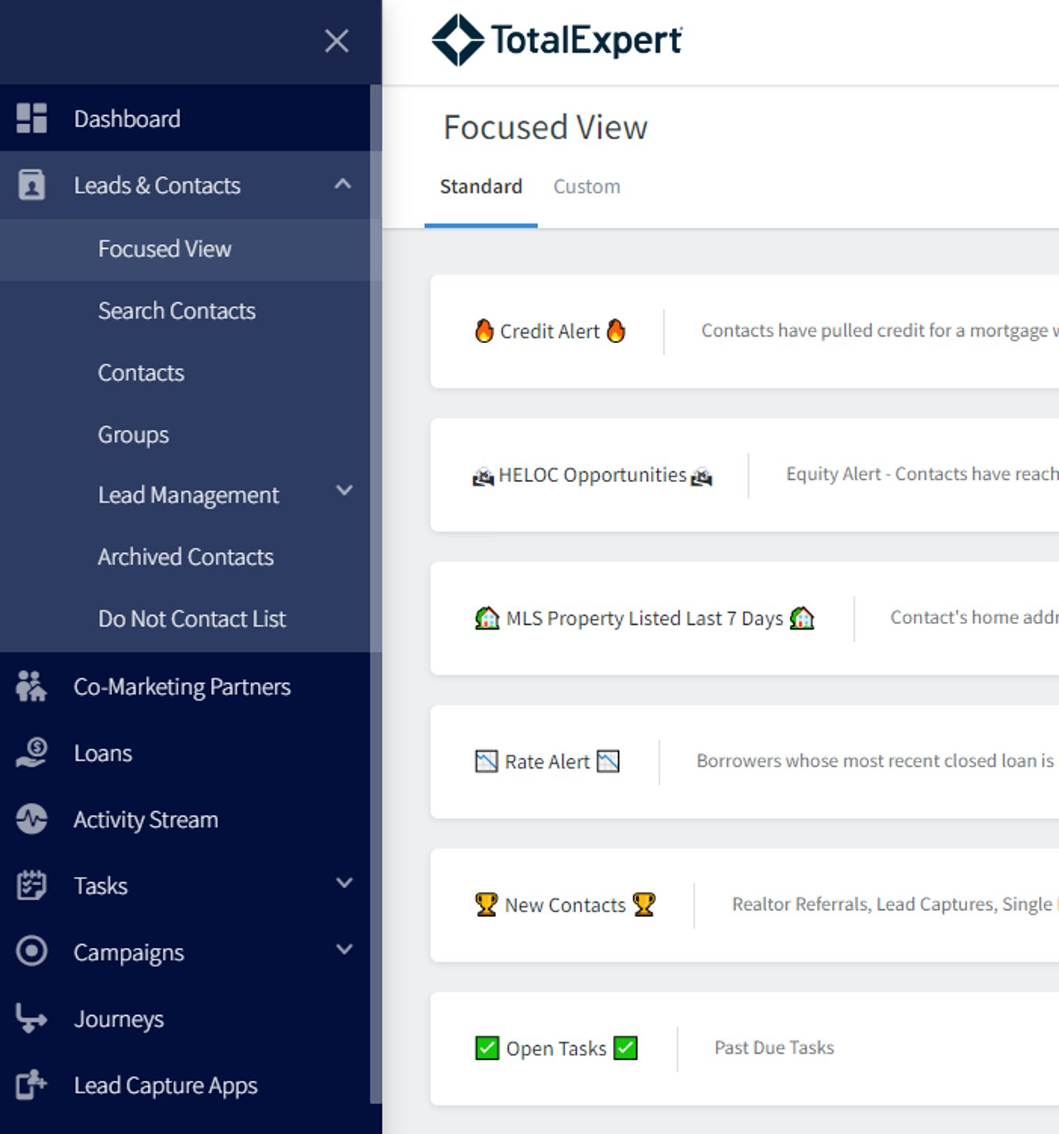
Focused View
Contacts will populate in Customer Intelligence Focused Views lists ​
Quickly work through your FV lists making personal outreach ​
Easily make notes, log outcome and assign follow-up tasks all on one screen

